Slide 1


Classifying Fruits (Apple vs. Orange) Based on Size and Color
PRESENTED BY
2303811724321095 – SAKTHI VISHAL C

Slide 2

PRESENTATION OVERVIEW
Problem Identification
Objective
Flow Diagram
Module Description
Screen Shot
Advantages
Conclusion

Slide 3
PROBLEM IDENTIFICATION
Traditional manual fruit classification is time-consuming and prone to errors.
Efficient fruit sorting is essential in agriculture, food processing, and retail industries.
Automating classification using size and color improves speed, accuracy, and efficiency.

Slide 4
OBJECTIVE
Develop an R-based fruit classification system that differentiates between Apples and Oranges
Use size and color intensity as primary classification features.
Implement a machine learning model to improve accuracy.

Slide 5
FLOW DIAGRAM
Data Collection
Feature Extraction
Prediction & Output
Pre-processing
Model Training

Slide 6
MODULE DESCRIPTION
Data Acquisition Module – Reads input data (CSV or user input).
Preprocessing Module – Cleans and normalizes feature values.
Feature Extraction Module – Extracts size and color properties.
Classification Module – Uses a trained ML model to classify fruits.
Output Module – Displays classification results.

Slide 7


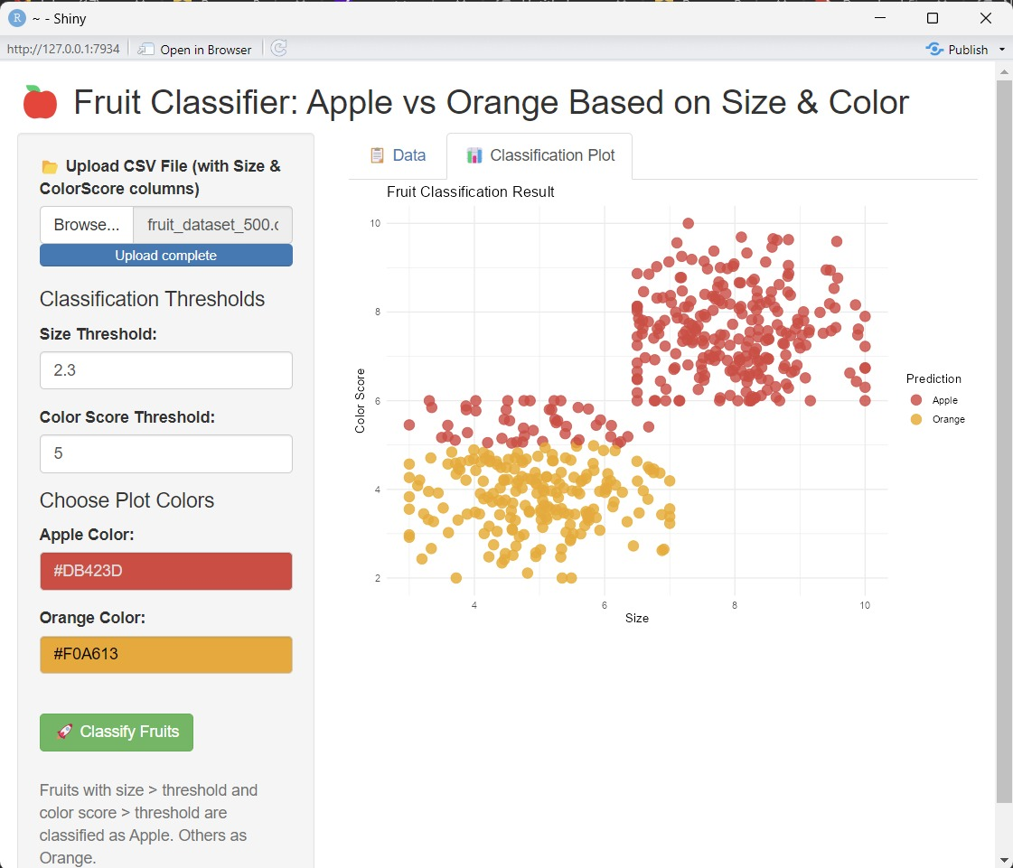
SCREENSHOT

Slide 8
ADVANTAGES
Automation & Efficiency – Eliminates manual classification, reducing labor costs and human errors.
High Accuracy – Uses machine learning to improve classification precision based on measurable features (size & color).
Fast Processing – Can classify fruits in real-time, making it useful for agricultural and retail industries.
Scalability – Can be extended to classify other fruits by adding more features (e.g., texture, shape).
User-Friendly – Implemented as an R Shiny app, allowing easy interaction with input sliders for size and color.

Slide 9
CONCLUSION
This project demonstrates an efficient and automated approach to classifying fruits (Apples vs. Oranges) based on size and color using machine learning in R.
The proposed system is fast, accurate, and scalable, making it useful for agriculture, food processing, and retail industries.

Slide 10
THANK YOU

